Slide 1
Epi 510: Data management in Stata I

Slide 2
Two more ways to explore your data: list & count

Slide 3
list lists values of variables
help list

Slide 4
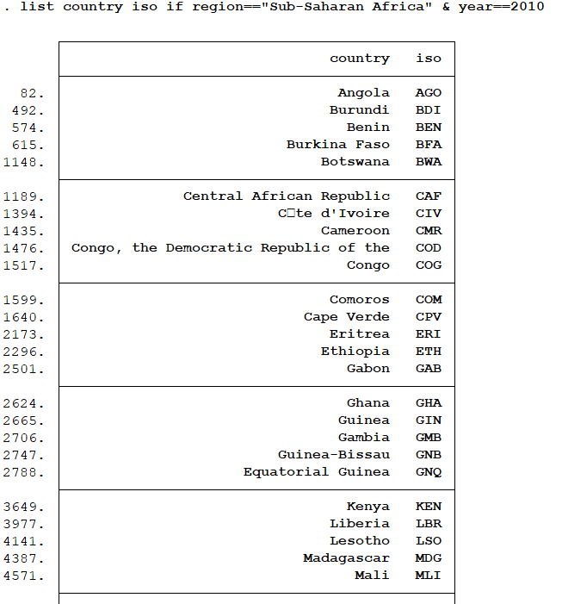
list country iso if ///
region=="Sub-Saharan Africa" ///
& year==2010

Slide 5
count count observations satisfying specified conditions
help count

Slide 6

count if region=="Sub-Saharan Africa" & year==2010

Slide 7
Importing foreign data formats

Slide 8
import delimited Read delimited ASCII (text) data (e.g. comma-delimited files)
help import delimited

Slide 9
Import worldBankCountryIndicators.csv
https://canvas.uw.edu/courses/1478728/files/81118529

Slide 10
import delimited using "worldBankCountryIndicators.csv", ///
clear varnames(1) case(preserve)
Notes:
Have to run together with /// at once

Slide 11
Saving & exporting data

Slide 12
save save a Stata-format (.dta) dataset
help save

Slide 13
save filename [, replace]
save “worldBankCountryIndicators.dta”, replace

Slide 14
export delimited Export to delimited ASCII (text) data file (e.g. comma-delimited files)
help export delimited
Notes:
Export to csv using export delimited

Slide 15
export delimited [varlist] using filename [if] [in] [, options]
export delimited using "worldBankCountryIndicators2.csv", replace

Slide 16
mkdir create a new directory
help mkdir

Slide 17
Create a directory in which to store your data, logs & do files during this class
mkdir "your_name"
C:/data/
C:/data/projectFiles/inputData
mkdir C:/data/projectFiles
mkdir C:/data/projectFiles/inputData
Notes:
For example, if you’re working on data and extracting annual data or you are outputting graphs and want to quickly make a graph directory within your code because its faster
If you want to create a folder in a different area (not working directory), just list full file path to the file you want to create
R has similar command called dir.create

Slide 18
Sorting the data

Slide 19
sort arranges observations by the values of specified variables
help sort

Slide 20
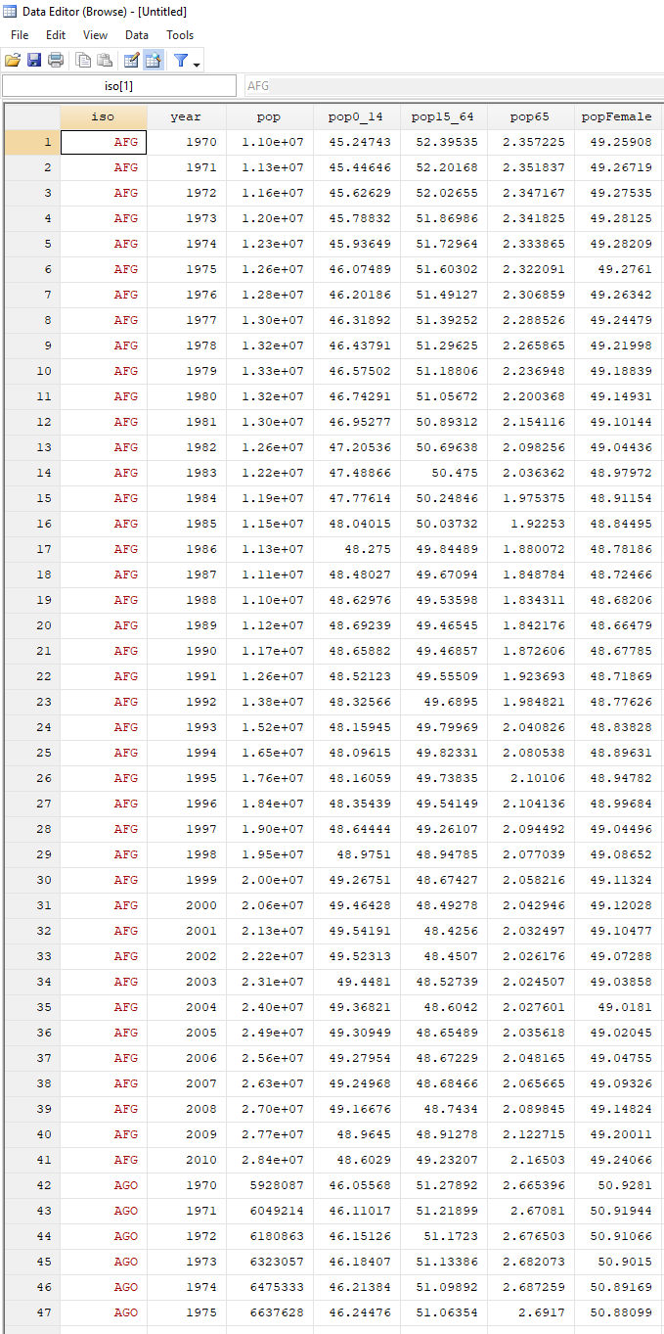
sort iso

Slide 21
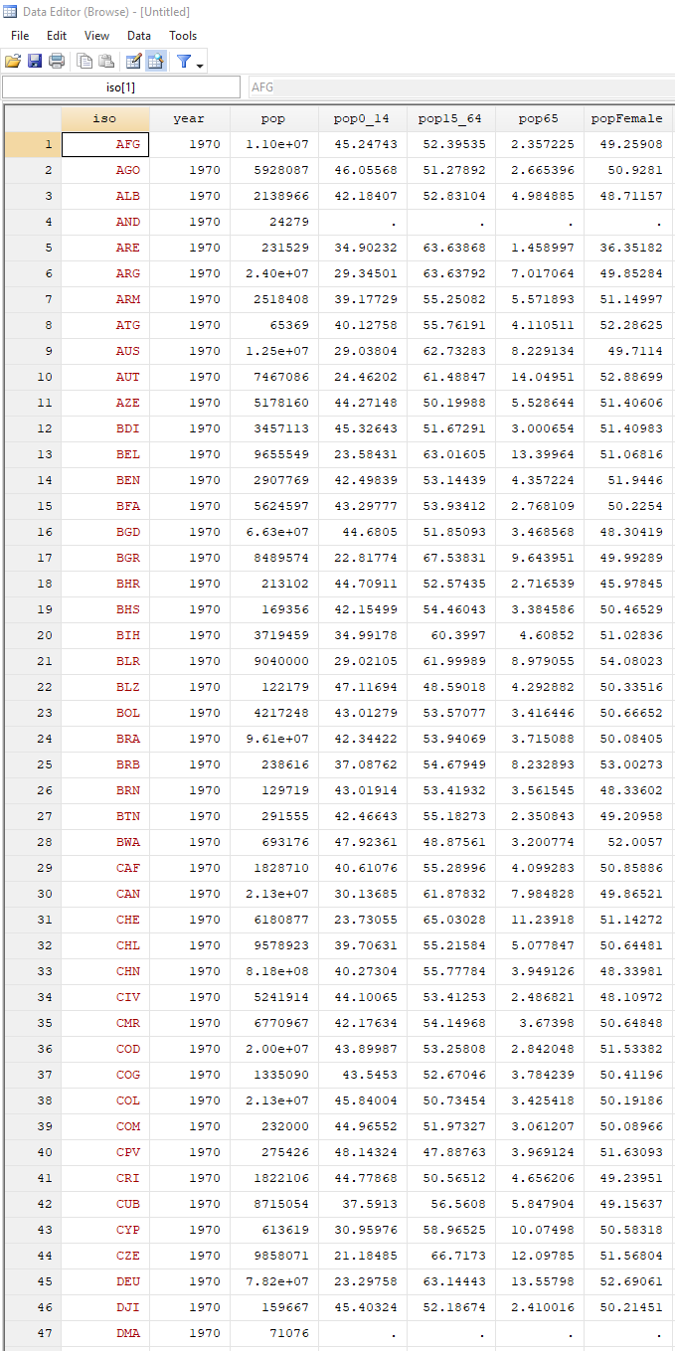
sort year iso

Slide 22
gsort arranges observations in either ascending or descending order of values of specified variables
help gsort

Slide 23
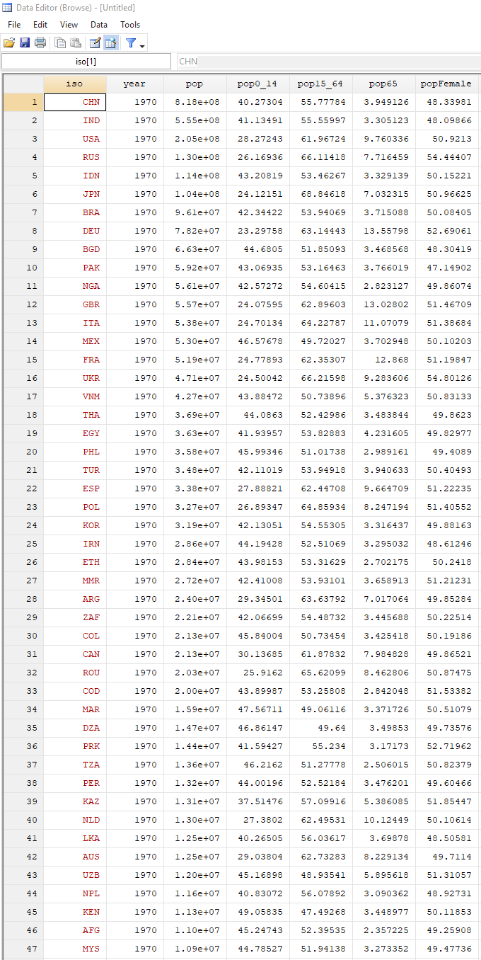
gsort year -pop

Slide 24
Ordering variables
To sort observations in order of the contents of variables we use either sort or gsort
To order your variables we use order
order varlist [, options]
Options Description
----------------------------------------------------------------------------------------- first move varlist to beginning of dataset; the default
last move varlist to end of dataset
before(varname) move varlist before varname
after(varname) move varlist after varname
alphabetic alphabetize varlist and move it to beginning of dataset
sequential alphabetize varlist keeping numbers sequential and move it to beginning of dataset
help order
Notes:
Move location of column

Slide 25
Deleting data

Slide 26
drop delete variables or observations
help drop

Slide 27
Drop variables
drop varlist
Drop observations meeting criteria
drop if exp
Drop a range of observations
drop in range [if exp]
You can drop variables or observations, but not both!
help drop
Notes:
Drop in 300-304 (by rows)
Have to drop variables and observations separately.
Drop hExp* oop*

Slide 28
keep retain variables or observations
help keep

Slide 29
Keep variables
keep varlist
Keep observations meeting criteria
keep if exp
Keep a range of observations
keep in range [if exp]
Notes:
Keep if expression (will keep observations that satisfy expression)
Keep if inrange (year, 2000, 2010)
Keep if year >=2000 & year <= 2010

Slide 30
Exercise

Slide 31
Working from worldBankCountryIndicators.csv, create a new dataset from a subset of the data:
Drop all variables related to health expenditures & out-of-pocket spending (hint: these start with hExp and oop)
Keep only observations from years 2000 through 2010, inclusive
Notes:
drop hExp* drop oop*
keep if year >=2000 & year <= 2010

Slide 33
Save your dataset to the directory you just created in both Stata & comma delimited formats (use a new filename – something to let you know that this is classroom exercise file)

Slide 34
export delimited using “wbIndicatorsStataSession3.csv", replace
save "wbIndicatorsStataSession3.dta", replace
Notes:
, replace – incase that file already exists, it will overwrite it
.dta stata format

Slide 35
Labels

Slide 36
Variable labels
Attach a pretty label to a variable
Name Label
beds Hospital beds (per 1,000 people)
help label

Slide 37
label variable attaches a label (up to 80 characters) to a variable
help label

Slide 38
label variable beds “Hospital beds (per 1,000 people)”
Notes:
If you want a word to have quotes around one word within label, it will confuse stata – if you want quotes in the label itself, use single quotation marks ‘’ (or you can use single quotes around entire label and double quotes within label – just can’t be same type of quotation marks.

Slide 39
Exercise

Slide 40
Label variables pop through popFemale as follows:
pop: “Population, total”
pop0_14: “Population ages 0-14 (% of total)”
pop15_64: “Population ages 15-64 (% of total)”
pop65: “Population ages 65+ (% of total)”
popFemale: “Population, female (% of total)”

Slide 42
Variable labels
Attach a pretty label to a variable
Name Label
beds Hospital beds (per 1,000 people)
help label

Slide 43
Value labels
Attach labels to different values of a variable
Example: complete enrollment variable
Value Label
0 "Enrollment <99%"
1 "Enrollment 99%+"
help label

Slide 44
label define create value label definition label values attach value label definition to the variable
help label

Slide 45
. tabulate completeEnroll
completeEnroll | Freq. Percent Cum.
---------------+-----------------------------------
0 | 1,085 80.61 80.61
1 | 261 19.39 100.00
---------------+-----------------------------------
Total | 1,346 100.00
. label define completeEnrollDef 0 "Enrollment <99%" 1 "Enrollment 99%+"
. label values completeEnroll completeEnrollDef
. tabulate completeEnroll
completeEnroll | Freq. Percent Cum.
----------------+-----------------------------------
Enrollment <99% | 1,085 80.61 80.61
Enrollment 99%+ | 261 19.39 100.00
----------------+-----------------------------------
Total | 1,346 100.00
Notes:
VariableDef = definition
If you’re creating a label you’ll apply to a lot (ex: yes/no), then call it yes/no or something
This DOES NOT change the underlying integer values, it’s just applying a label (not like a factor variable in R)

Slide 46
Create a categorical variable from natIncomeGrowth, define & apply value labels:
Nat. Income Growth | New Variable | Label
≤-1 | -1 | “Negative”
>-1 to <1 | 0 | “Stable”
≥1 | 1 | “Positive”

Slide 48
labelbook displays value label information
help labelbook

Slide 49
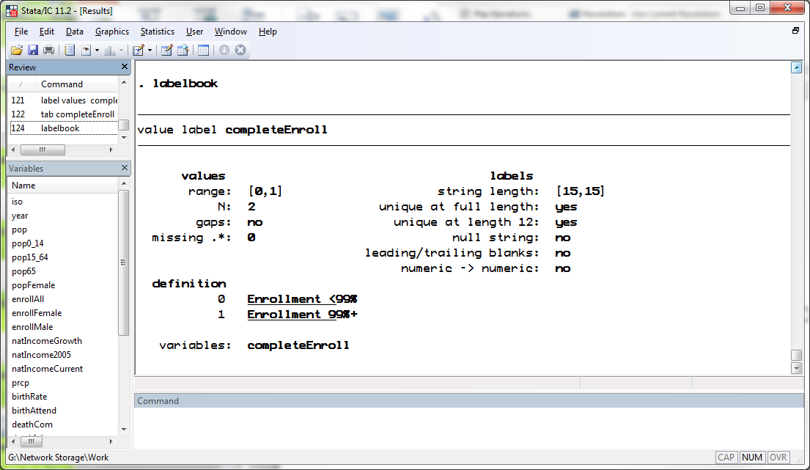

Slide 50
Date, math, & string functions

Slide 51
Dates: Four ways to store dates in Stata
 | Readability | Usability | Transferability
Components (e.g. day, month, and year vars) | Moderate | Low | High
Human Readable Format (HRF) (e.g. "12 Dec 2020") | High | Low | Moderate
Stata Internal Format (SIF) (e.g. days since 01jan1960 = 18,282) | Low | High | Moderate
Formatted SID (e.g. SIF with HRF labels) | High | High | Low
help datetime

Slide 52
Creating & formatting SIF dates from components
generate date = mdy(month, day, year)
format %td date
display mdy(12, 1, 2019)
21884
display %td mdy(12, 1, 2019)
01dec2019
From HRF
help datetime

Slide 53
Creating & formatting SIF dates from HRFs
generate date = date(HRFstr, mask)
format %td date
display date("01/12/2019", "DMY")
21884
display %td date("01/12/2019", "DMY")
01dec2019
From HRF
help datetime

Slide 54
Extracting components from SIF dates
. display %td 21884
01dec2019
. display year(21884)
2019
. display month(21884)
12
. display day(21884)
1
. display dow(21884)
0
. display doy(21884)
335
help datetime

Slide 55
Creating HRFs from SIF dates
generate datestr = string(sif, "%td")
. display string(21884, "%td")
01dec2019
help datetime

Slide 56
Math functions
abs(x) Absolute value of x
exp(x) e^{x}
ln(x) natural log of x
log10(x) base-10 log of x
max(x1…xn) max of x1…xn
min(x1…xn) min of x1…xn
mod(x,y) modulus of x with respect to y
sqrt(x) square-root of x
help functions

Slide 57
Math functions: rounding
ceil(x) x rounded up
floor(x) x rounded down
int(x) x rounded toward 0
round(x) x rounded to nearest integer
round(x,y) x rounded to nearest multiple of y
help functions

Slide 58
String functions
abbrev(s,x) s abbreviated to x characters
lower(s) s in lowercase
proper(s) s in titlecase
strmatch(s1,s2) returns 1 if s2 is found in s1
strpos(s1,s2) position in s1 where s2 is first found
subinstr(s1,s2,s3,n) s1 with n instances of s2 replaced with s3
substr(s,n1,n2) substring of s starting at character n1, and n2 characters long
upper(s) s in uppercase
wordcount(s) number of words in s
help functions

Slide 59
display lower("UNITED KINGDOM")
united kingdom
display proper("UNITED KINGDOM")
United Kingdom
display wordcount("UNITED KINGDOM")
2
display upper(lower("UNITED KINGDOM"))
UNITED KINGDOM
generate lcCountry = lower(country)

Slide 60
display subinstr("Let's replace the spaces", " ", "_", .)
Let's_replace_the_spaces

Slide 61
use "gbdChildMortalityData.dta", clear

Slide 62
tab gbdRegion
GBD Region | Freq. Percent Cum.
-----------------------------+-----------------------------------
Asia Pacific, High Income | 164 2.15 2.15
Asia, Central | 369 4.83 6.97
Asia, East | 120 1.57 8.54
Asia, South | 246 3.22 11.76
Asia, Southeast | 533 6.97 18.74
Australasia | 82 1.07 19.81
Caribbean | 615 8.05 27.86
Europe, Central | 533 6.97 34.83
Europe, Eastern | 287 3.76 38.58
Europe, Western | 902 11.80 50.39
Latin America, Andean | 123 1.61 52.00
Latin America, Central | 369 4.83 56.82
Latin America, Southern | 123 1.61 58.43
Latin America, Tropical | 82 1.07 59.51
North Africa / Middle East | 779 10.19 69.70
North America, High Income | 82 1.07 70.77
Oceania | 348 4.55 75.32
Sub-Saharan Africa, Central | 246 3.22 78.54
Sub-Saharan Africa, East | 615 8.05 86.59
Sub-Saharan Africa, Southern | 246 3.22 89.81
Sub-Saharan Africa, West | 779 10.19 100.00
-----------------------------+-----------------------------------

Slide 63
gen asia = strmatch(gbdRegion, "Asia*") if !missing(gbdRegion)
gen asia = strmatch(lower(gbdRegion), "*asia*") if !missing(gbdRegion)
gen asia = 2 - strmatch(gbdRegion, "Asia*") if !missing(gbdRegion)

Slide 64
tab gbdRegion asia, missing
| asia
GBD Region | 0 1 | Total
----------------------+----------------------+----------
Asia Pacific, High In | 0 164 | 164
Asia, Central | 0 369 | 369
Asia, East | 0 120 | 120
Asia, South | 0 246 | 246
Asia, Southeast | 0 533 | 533
Australasia | 82 0 | 82
Caribbean | 615 0 | 615
Europe, Central | 533 0 | 533
Europe, Eastern | 287 0 | 287
Europe, Western | 902 0 | 902
Latin America, Andean | 123 0 | 123
Latin America, Centra | 369 0 | 369
Latin America, Southe | 123 0 | 123
Latin America, Tropic | 82 0 | 82
North Africa / Middle | 779 0 | 779
North America, High I | 82 0 | 82
Oceania | 348 0 | 348
Sub-Saharan Africa, C | 246 0 | 246
Sub-Saharan Africa, E | 615 0 | 615
Sub-Saharan Africa, S | 246 0 | 246
Sub-Saharan Africa, W | 779 0 | 779
----------------------+----------------------+----------
Total | 6,211 1,432 | 7,643

Slide 65
generate highIncomeTemp = strmatch(lower(income),"*high*") if !missing(income)
tab income highIncomeTemp, missing
| highIncomeTemp
Income Group | 0 1 . | Total
---------------------+---------------------------------+----------
| 0 0 38 | 38
High income: OECD | 0 1,271 0 | 1,271
High income: nonOECD | 0 861 0 | 861
Low income | 1,435 0 0 | 1,435
Lower middle income | 1,927 0 0 | 1,927
Upper middle income | 2,111 0 0 | 2,111
---------------------+---------------------------------+----------
Total | 5,473 2,132 38 | 7,643

Slide 66
Exercise

Slide 67
Create a variable containing region in lowercase
Create another variable with region in lowercase and spaces replaced by underscores (“_”).

Slide 69
Numeric-string conversion

Slide 70
numeric variable
(e.g. year == 1990)
tostring
destring
string variable with numeric content
(e.g. year == “1990”)

Slide 71
. tostring year, generate(yearStr)
yearStr generated as str4
. tostring year, replace
year was int now str4
. destring year, replace
year has all characters numeric; replaced as int

Slide 72
string variable
encode
decode
labeled numeric variable

Slide 73
. encode region, gen(regionCode)
. labelbook regionCode
------------------------------------------------------------------------------
value label regionCode
------------------------------------------------------------------------------
values labels
range: [1,7] string length: [10,26]
N: 7 unique at full length: yes
gaps: no unique at length 12: yes
missing .*: 0 null string: no
leading/trailing blanks: no
numeric -> numeric: no
definition
1 East Asia & Pacific
2 Europe & Central Asia
3 Latin America & Caribbean
4 Middle East & North Africa
5 North America
6 South Asia
7 Sub-Saharan Africa
variables: regionCode

Slide 74
Extended generation functions

Slide 75
egen generate a new variable using extended generation functions
help egen

Slide 76
Create a constant variable containing the minimum value of the variable pop
egen minPop = min(pop)
Create a constant variable containing the total (sum) of all observations of the variable pop
egen totalPop = total(pop)
help egen

Slide 77
Exercise

Slide 78
Create a new variable that contains the total number of under-five deaths.
Create a variable that contains the mean under 5 mortality rate

